Slide 1
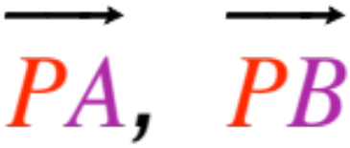
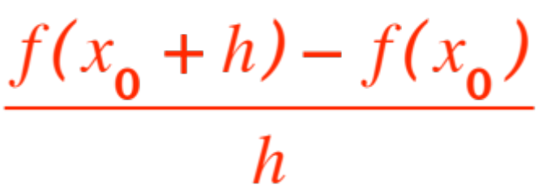



LIMITS
We are going to make sense of vague statements like
… limiting value of slopes of secants
as A and B get close to P (remember?)
or
… limiting value of the ratio
as gets close to (remember?)
We are going to learn the concept of

Slide 2
As usual the English language (or any other) has two meanings for the word limit. One means
a bound, as in a person of “limited intelligence” or “limited means” or “limited social graces”.
The other meaning is as a value or position to be approached but maybe never reached. This is the one that is fundamental to all Calculus, from the one we are studying to the most esoteric reaches of Analysis, Complex Variables, etc.
I urge you to do your best (regardless of your intended major) to grasp it securely.

Slide 3
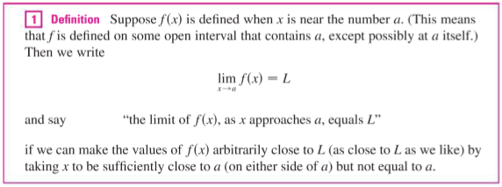
With a couple of needed amendments, our book does a decent job of defining what we mean with these (admittedly vague) statements. Here is the book’s definition:

Slide 4
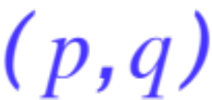





Amendment no. 1 is that the open interval
where is defined need not contain (if it does, hallelujah!), it could just have as one of its bounds. In other words we may be able to get close to just from one side. In fact this notion of getting close to from one side only makes sense even when is inside . We get two “one sided” limits, we will return to them later.
Amendment no. 2 is a little deeper. It’s not enough to be able to get arbitrarily close to by choosing sufficiently close to . The correct statement is that

Slide 5




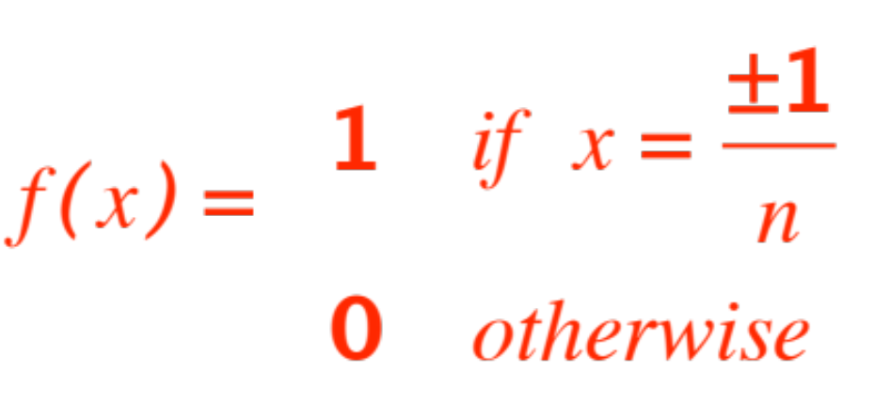
Once you have decided how close you want to get to , you can THEN decide how close you should stay to , and all ‘s that are that close to the point MUST give you values of that are as close to as you had decided. An example will help:
Here is a function

Slide 6
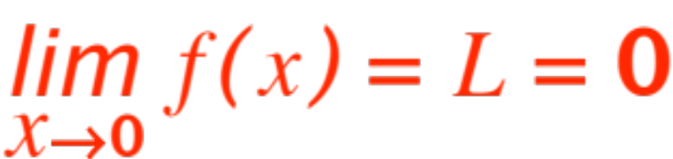

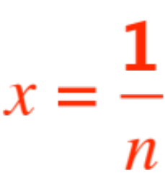


One would like to say that
and indeed you can get as close to as you please, as long as you don’t pick . No matter how sufficiently close you are to , one of these nuisance ‘s will be there to mess you up!

Slide 7

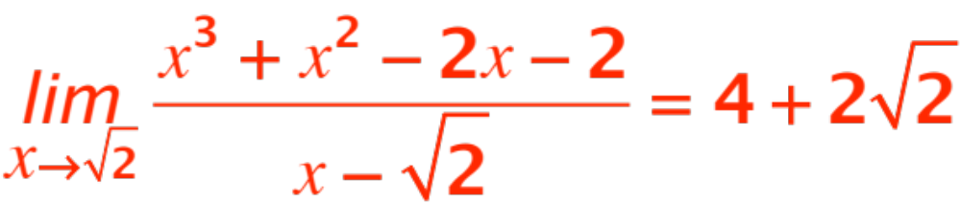
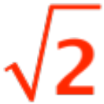
End of amendments.
One of the important things to remember about limits is that the value of plays no role (it may not even exist if is not defined at ).
For example, we will learn later that
But the function is not defined at (why?)

Slide 8
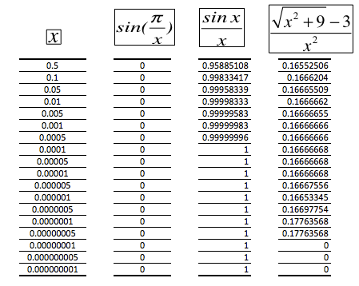
WARNING
Your calculator may lead you astray! Here is a table of three functions, with decreasing ‘s.
Notes:
For the first function, take x = 2/(4n+1), n = 0, 1, 2, 3, … you get value 1 always
x = 2/(4n+3), n = 0, 1, 2, 3, … you get value -1 always

Slide 9


We will learn later how to compute limits correctly and avoid pitfalls.
But first we want to introduce two additional kinds of limits, called respectively one-sided and infinite.
One-sided. The idea, which we have already met, is to limit (in the meaning of bounding ourselves to… ☺) the values of to be just on one side of
(if it makes sense, i.e. the function is defined on that side). Obviously we can have two sides, coming in towards from the left or the right

Slide 10
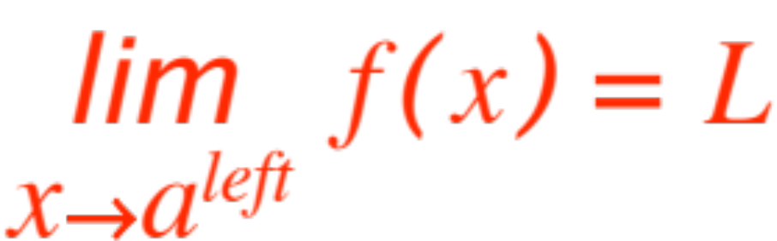
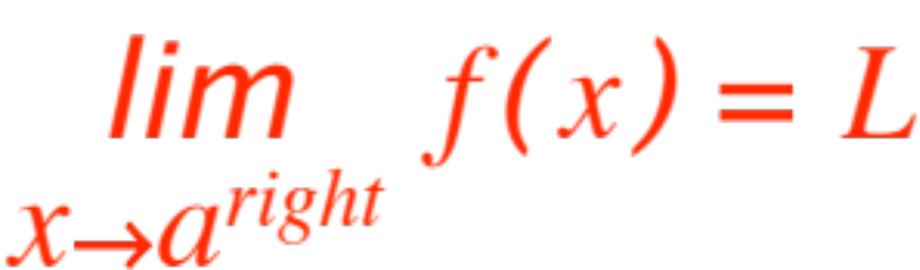
The main difficulty here is to invent an appropriate notation. Let me propose (self explanatory)
and

Slide 11
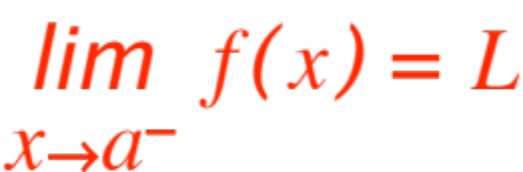
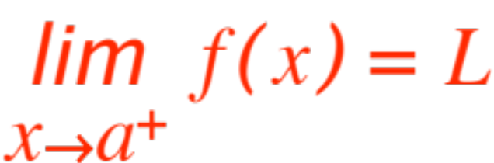
Why is this not acceptable?
Only that it is not the customary one, people use
instead of
and
instead of
“left”and “right”are words, mathematicians prefer symbols, they are international, shorter and just as clear once you agree on the meaning!

Slide 12

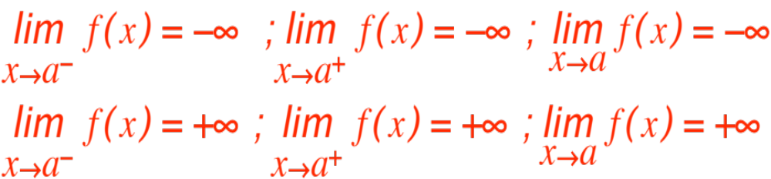
One last kind of limit, the infinite(s) one(s)
The idea is rather simple, instead of asking that the function get close to some number (as gets close to ) we require instead that the values of get arbitrarily large (positive or negative, consistently.) We write the six limits:
With obvious meanings. Now do the homework!

